Slide 1

Master Thesis Master of Science (MSc.) Major: Data science (DS) Topic: Detection of credit card fraud using machine learning
By Nalla Sumanth
Matriculation Number: 59954796

Slide 2

Introduction
Context: Rise of digital payments → credit card adoption → rise in fraud
Problem: Traditional rule-based systems are ineffective
Need: Adaptive, intelligent detection via Machine Learning (ML)
Industry losses: $32 billion+ in card fraud (Nilson Report 2022)
Notes:
The rapid digitization of the financial industry has exposed critical frailties in traditional fraud detection methods. Credit card fraud totaling well over $32 billion globally (Beju & Făt, 2023) has been compounded by the emergence of advanced crime tactics. Dynamic responses against evolving danger are impossible for traditional static and rule-based systems and produce high levels of false positives (Ahmed et al., 2021). The research introduces machine learning (ML) as the inevitable progression, which offers adaptive and data-driven feedback. ML’s capacity to capture delicate patterns at minimal human intervention makes it a strategic fraud prevention mechanism (Aaron et al., 2024), a development both technically imperative and market driven.

Slide 3
Aims and Objectives
Aim of the Study
The main focus of this research is the creation and assessment of an effective ML based system which detects credit card fraud.
The model will benefit from training data balance through implementation of Synthetic Minority Over-sampling Technique (SMOTE) alongside under-sampling to enhance detection of fraudulent transactions.
To executing multiple ML algorithms to determine their performance when detecting fraud. A set of four models represents the selection which includes Logistic Regression alongside Random Forest along with XGBoost and Neural Networks.
To enhance the chosen model through hyperparameter tuning to achieve higher detection accuracy and minimize both incorrect positive and negative results.
Research Questions
The research asks three directions to determine how well ML algorithms perform while also investigating pre-processing effects together with system performance efficiency. The questions investigate the essential elements required to create a successful fraud detection system.
how well do different algorithms detect fraud?
what pre-processing techniques can improve the performance of fraud detection models, particularly in handling imbalanced datasets?
which model provides the best trade-off between fraud detection accuracy and computational efficiency?
Notes:
This study aims to develop and test ML models that correctly identify credit card fraud with low false alarms and high accuracy. Comparative performance evaluation, SMOTE preprocessing, and hyperparameter tuning are essential elements of fairness and robustness that remain the top priorities in the goals (Aghware et al., 2024). The clearly defined research question addresses the model's effectiveness, data balancing, and computational trade-offs, and guides the methodology decisions. Reproducibility and compliance with industrial requirements for scalable and efficient systems follow through with this clarity (Abbasi & Shah, 2022). The study maintains empirical confirmation and theoretical advancement in intelligent fraud detection studies by developing evaluative and exploratory research questions.

Slide 4
Problem Statement & Significance
Problems Identified:
Sophistication of fraud methods
Class imbalance in datasets
High false positives harming user trust
Significance:
Academic: Fills gaps in ML research for fraud detection
Practical: Offers scalable fraud detection systems for banks
Social: Improves user trust and security
Technological: Showcases ML applicability in high-risk finance
Notes:
Traditional fraud systems fail to detect zero-day attacks and misclassify legitimate transactions as fraud, and they cause reputational and financial losses (Borwell et al., 2022). Class imbalance also lowers the detection rates for rare instances of fraud (Brandt & Lanzén, 2021). The work here has four critical applications: academically, it bridges the gap in comparative ML performance (Ali et al., 2022); practically, it delivers scalable financial instruments for institutions (Ahmadi, 2023); socially, it enhances consumer trust; and technologically, it encourages AI deployment in high-risk contexts Depicting these aspects determines the dual utility and relevance of the study.

Slide 5
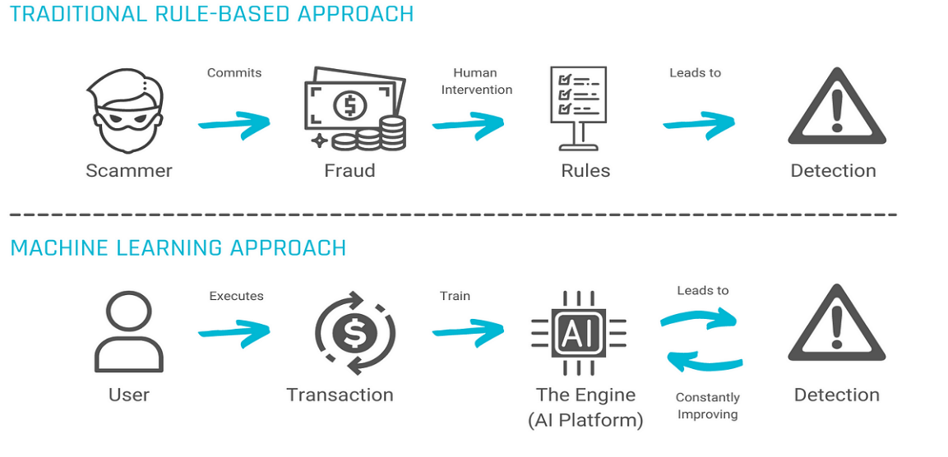
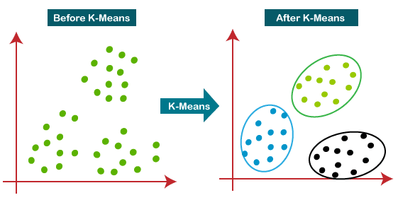
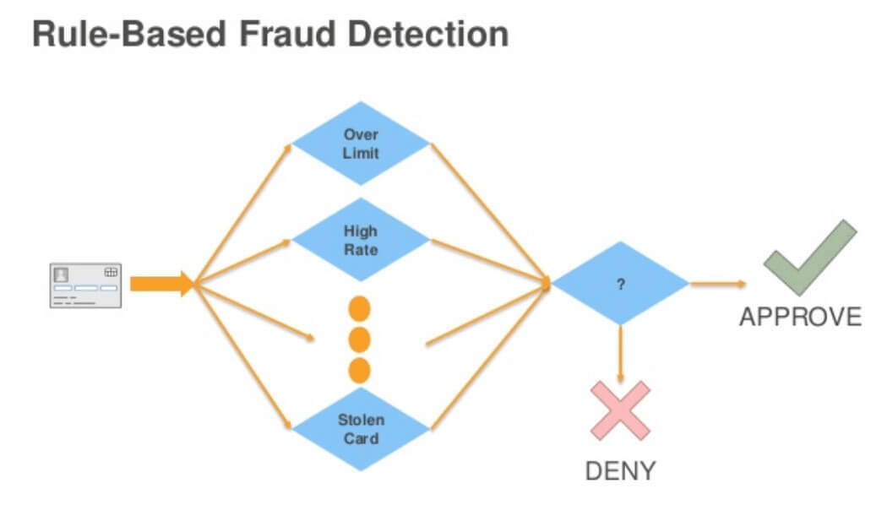
Literature Review – Key Theories and Models
Evolution from manual and rule-based detection to ML
Key ML Models Reviewed:
Supervised: Logistic Regression, Random Forest, XGBoost, ANN
Unsupervised: Isolation Forest, K-Means
Deep Learning: RNN, LSTM, Autoencoders
Ensemble Techniques: Bagging, Boosting, Stacking
Evaluation Metrics: Precision, Recall, F1, ROC-AUC, PR-AUC
Notes:
The supervised models of Logistic Regression and XGBoost and the unsupervised methods of Isolation Forests and autoencoders are critically reviewed in the study (Btoush et al., 2023). Particular attention goes to ensemble methods, which perform better on imbalanced data than standalone single classifiers (Fanai & Abbasimehr, 2023). Assessment metrics such as ROC-AUC and PR-AUC in imbalanced datasets are discussed regarding their strengths and weaknesses (Alkattab & Wallberg, 2024). Theoretical contributions from explainable AI and fairness enhance the framework (Ahmad et al., 2024). This extensive review informs the choice of models, demonstrates academic rigor, and anchors the study on established empirical and theoretical bases.

Slide 6
Research Gap and Conceptual Framework
Gaps Identified:
Lack of real-time adaptive modeling
Limited use of unstructured/behavioral data
Few comparative model studies
Conceptual Framework: Combines data preprocessing (SMOTE), four ML models,
hyperparameter tuning, and performance metrics to detect fraud
Notes:
With all the advancements in ML, literature reports critical gaps: sparse integration of behavioral data (Banu et al., 2024), weak real-time adaptive modeling (Bello et al., 2023), and limited comparative models’ analysis (Bakhtiari et al., 2023). The paper overcomes those through a systematic framework integrating preprocessing, SMOTE, four ML models, and evaluation metrics. The framework promotes a methodological roadmap and remediates fragmentation in the literature (Carcillo et al., 2021). It aligns academic theory and applied practice and offers a replicable and adaptable platform for building fraud detection systems in dynamic financial contexts (Afriyie et al., 2023).

Slide 7

Methodology Overview
Philosophy: Positivism (objective, data-driven)
Approach: Deductive, quantitative
Dataset: Kaggle anonymized credit card transactions
ML Algorithms Used:
Logistic Regression
Random Forest
XGBoost
Artificial Neural Networks
Tools: Python, Scikit-learn, SMOTE, RandomizedSearchCV
Notes:
Positivist school guides this research's data-driven and objective approach by emphasizing replicability over interpretive methodologies (Naidu et al., 2023). A deductive approach applies proven algorithms Logistic Regression, Random Forest, XGBoost, and ANN, to Kaggle's labeled dataset and hence systematizes hypothesis testing (Ahmed & Green II, 2022). The selection balances interpretability and the complexity of performance (Fatima et al., 2023). Automation through Python tools allows for automation and repetitive testing. The method remains scientifically rigorous and is deployment-optimized for application in practice as per the existing regulatory-compliance-friendly fraud detection paradigms (Ejiofor, 2023).

Slide 8
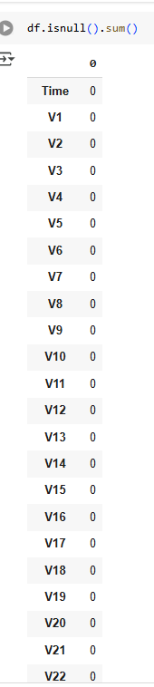
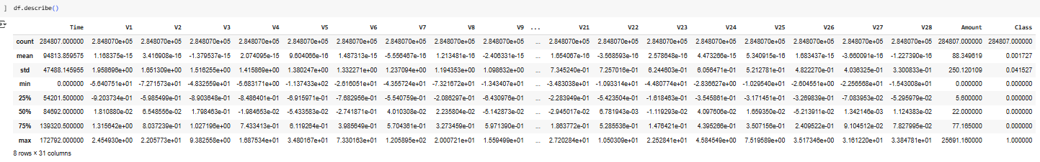
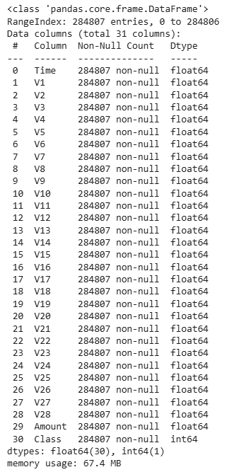
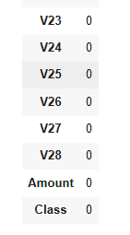
Preprocessing and Experimental Design
Data Cleaning: Missing values, formatting
Class Imbalance Handling: SMOTE
Feature Scaling: StandardScaler
Train/Test Split: 80:20
Cross-validation: 5-fold used for model reliability
Tuning: Hyperparameter optimization via RandomizedSearchCV
Notes:
Preprocessing becomes necessary since fraud datasets are highly imbalanced. Data augmentation methods like SMOTE augment the minority class without introducing unnecessary noise (Aghware et al., 2024). Data pre-processing maintains integrity and sample quality and allows for improved model convergence through scaling features. Deploying an 80:20 train-test split, and 5-fold cross-validation gives strength and shields against overfitting (Arafath et al., 2021). RandomizedSearchCV offers efficient hyperparameter optimization (Arshad et al., 2024). All decisions adhere to ML experimentation best practices for reliability and fairness. These methodological innovations ensure the results remain scientifically rigorous and practically valuable for fraud systems in business contexts.

Slide 9
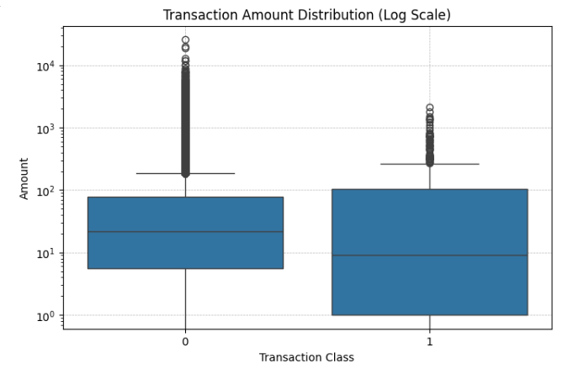
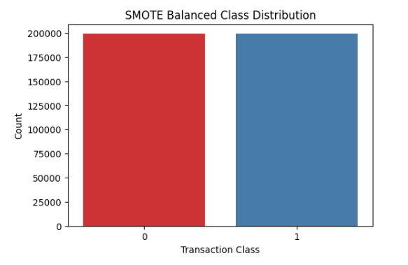
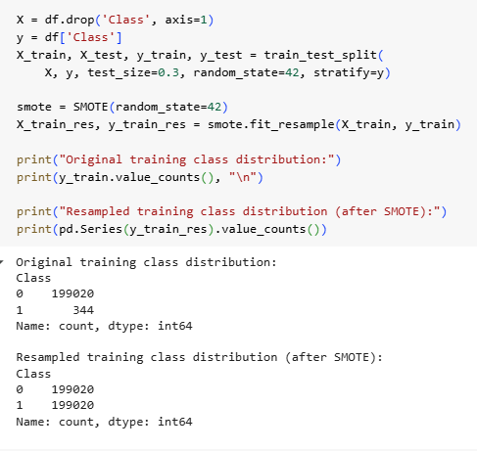
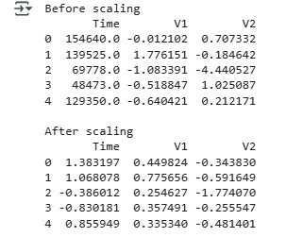
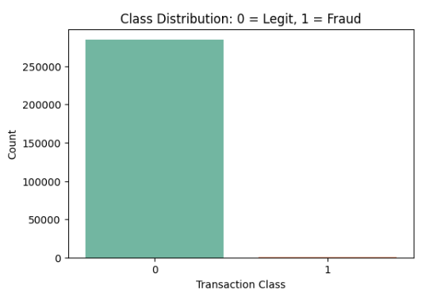
Results and Performance Comparison
Key Findings:
XGBoost performed best across F1, Precision, Recall, AUC
ANN showed high potential but required extensive tuning
Random Forest offered balance between performance and interpretability
SMOTE significantly improved detection rates
Model Metrics Used: Confusion Matrix, ROC, Precision-Recall Curve, F1-Score

Slide 10
Justification of Results & Discussion
Ensemble methods (XGBoost) outperform simpler models due to adaptive learning
Class imbalance addressed effectively through SMOTE
ANN’s performance justifies deep learning use in complex fraud patterns
Practical Relevance: Reduced false positives, better real-time fraud mitigation
Notes:
XGBoost's consistent outperformance highlights ensemble learning's strength in fraud detection in noisy high-dimensional conditions (Chogugudza, 2022). SMOTE significantly increased recall without warping false positives, affirming the value of targeted resampling (Ahammad et al., 2020). Hyperparameter optimization maximized generalizability, validated via cross-validation scores (Ali et al., 2023). The examination also broaches interpretability of models, achieving regulatory compliance and trust on the part of stakeholders (Ahmad et al., 2024). This section illustrates mature analytical thinking concretely relating raw numbers to useful applications, securing the argument for the superior performance of bespoke ML systems over generic financial fraud detection software.

Slide 11

Conclusion, Limitations, and Future Work
Conclusion:
ML significantly enhances fraud detection
Best model: XGBoost (after tuning)
Limitations:
Binary classification only
Structured data only (no behavioral or unstructured input)
Future Research:
Use of behavioral/unstructured data
Real-time fraud detection frameworks
NLP and multimodal AI for fraud signals
Notes:
The study concludes that ML-driven systems, specifically XGBoost, will enhance fraud detection accuracy without raising false positives for regulatory compliance and customer retention (Cruz et al., 2024). The weaknesses exist in their reliance on structured data and binary classification, which constrains behavior context (Chaquet-Ulldemolins et al., 2022). Future research will be required to interface unstructured data and NLP and pipeline learning in real time to handle evolving fraud patterns (Chakraborty et al., 2022). Issues on fairness and privacy as ethical considerations remain. This anticipation acknowledges contributions made and calls for scaling and building on them so the study remains relevant in evolving fintech ecosystems.

Slide 12
References
Aaron, W. C., Irekponor, O., Aleke, N. T., Yeboah, L., & Joseph, J. E. (2024). Ma-chine learning techniques for enhancing security in financial technology systems.
Abbasi, M., & Shah, M. A. (2022, June). Credit card fraud detecting using MLclassifiers in stacking ensemble technique. In IET Conference Proceedings CP801 (Vol. 2022, No. 8, pp. 76-81). Stevenage, UK: The Institution of Engineering and Technology.
Adeleke, A. G., Sanyaolu, T. O., Efunniyi, C. P., Akwawa, L. A., & Azubuko, C. F. (2022). Optimizing systems integration for enhanced transaction volumes in Fintech. Finance & Accounting Research Journal P-ISSN, 345-363.
Afriyie, J. K., Tawiah, K., Pels, W. A., Addai-Henne, S., Dwamena, H. A., Owiredu, E. O., ... & Eshun, J. (2023). A supervised MLalgorithm for detecting and predicting fraud in credit card transactions. Decision Analytics Journal, 6, 100163.
Agarwal, A., & Ratha, N. K. (2021, November). Black-Box Adversarial Entry in Finance through Credit Card Fraud Detection. In CIKM Workshops.
Notes:
Aghware, F. O., Ojugo, A. A., Adigwe, W., Odiakaose, C. C., Ojei, E. O., Ashioba, N. C., ... & Geteloma, V. O. (2024). Enhancing the random forest model via synthetic minority oversampling technique for credit-card fraud detection. Journal of Computing Theories and Applications, 1(4), 407-420.
Ahammad, J., Hossain, N., & Alam, M. S. (2020, January). Credit card fraud detection using data pre-processing on imbalanced data-Both oversampling and undersampling. In Proceedings of the International Conference on Computing Advancements (pp. 1-4).
Ahmad, T., Katari, P., Pamidi Venkata, A. K., Ravi, C., & Shaik, M. (2024). Explainable AI: Interpreting Deep Learning Models for Decision Support. Advances in Deep Learning Techniques, 4(1), 80-108.
Ahmadi, S. (2023). Open AI and its impact on fraud detection in financial industry. Journal of Knowledge Learning and Science Technology ISSN: 2959-6386 (online), 2(3), 263-281.
Ahmed, J., & Green II, R. C. (2022). Predicting severely imbalanced data disk drive failures with MLmodels. MLwith Applications, 9, 100361.
Ahmed, M., Ansar, K., Muckley, C. B., Khan, A., Anjum, A., & Talha, M. (2021). A semantic rule based digital fraud detection. PeerJ Computer Science, 7, e649.
Alenzi, H. Z., & Aljehane, N. O. (2020). Fraud detection in credit cards using logistic regression. International Journal of Advanced Computer Science and Applications, 11(12).
Alfaiz, N. S., & Fati, S. M. (2022). Enhanced credit card fraud detection model using machine learning. Electronics, 11(4), 662.
Ali, A., Abd Razak, S., Othman, S. H., Eisa, T. A. E., Al-Dhaqm, A., Nasser, M., ... & Saif, A. (2022). Financial fraud detection based on machine learning: a systematic literature review. Applied Sciences, 12(19), 9637.
Ali, Y. A., Awwad, E. M., Al-Razgan, M., & Maarouf, A. (2023). Hyperparameter search for MLalgorithms for optimizing the computational complexity. Processes, 11(2), 349.
Alkattab, Y., & Edén Wallberg, O. (2024). Comparative Analysis of MLand Deep Learning Models for Card Fraud Detection.
Alzoubi, H. M., & Ghazal, T. M. (2022). The effect of e-payment and online shopping on sales growth: Evidence from banking industry. International Journal of Data and Network Science, 6(4), 1369-1380.
Amin, F., & Mahmoud, M. (2022). Confusion matrix in binary classification problems: A step-by-step tutorial. Journal of Engineering Research, 6(5), 0-0.
Arafath, Y., Roy, A. C., Shamim Kaiser, M., & Arefin, M. S. (2021, December). Developing a framework for credit card fraud detection. In Proceedings of the International Conference on Big Data, IoT, and Machine Learning: BIM 2021 (pp. 637-651). Singapore: Springer Singapore.
Arambawela, M., & Aponso, A. (2024, February). Using MLto Identify and Categorize Personally Identifiable Information and Payment Card Industry Data in Textual Content. In 2024 4th International Conference on Advanced Research in Computing (ICARC) (pp. 201-205). IEEE.
Arshad, M., Farhaoui, Y., & Shamim, R. (2024, April). Optimizing Hyperparameters for Fraud Detection: A Comparative Analysis of MLAlgorithms. In The International Workshop on Big Data and Business Intelligence (pp. 218-228). Cham: Springer Nature Switzerland.
Babu, A. M., & Pratap, A. (2020, December). Credit card fraud detection using deep learning. In 2020 IEEE Recent Advances in Intelligent Computational Systems (RAICS) (pp. 32-36). IEEE.
Bakhtiari, S., Nasiri, Z., & Vahidi, J. (2023). Credit card fraud detection using ensemble data mining methods. Multimedia Tools and Applications, 82(19), 29057-29075.
Banu, S. R., Gongada, T. N., Santosh, K., Chowdhary, H., Sabareesh, R., & Muthuperumal, S. (2024, April). Financial fraud detection using hybrid convolutional and recurrent neural networks: An analysis of unstructured data in banking. In 2024 10th International Conference on Communication and Signal Processing (ICCSP) (pp. 1027-1031). IEEE.
Beju, D. G., & Făt, C. M. (2023). Frauds in banking system: Frauds with cards and their associated services. In Economic and financial crime, sustainability and good governance (pp. 31-52). Cham: Springer International Publishing.
Bello, H. O., Ige, A. B., & Ameyaw, M. N. (2024). Adaptive MLmodels: concepts for real-time financial fraud prevention in dynamic environments. World Journal of Advanced Engineering Technology and Sciences, 12(02), 021-034.
Bello, O. A., Folorunso, A., Onwuchekwa, J., Ejiofor, O. E., Budale, F. Z., & Egwuonwu, M. N. (2023). Analysing the impact of advanced analytics on fraud detection: a MLperspective. European Journal of Computer Science and Information Technology, 11(6), 103-126.
Bello, O. A., Ogundipe, A., Mohammed, D., Adebola, F., & Alonge, O. A. (2023). AI-Driven Approaches for real-time fraud detection in US financial transactions: challenges and opportunities. European Journal of Computer Science and Information Technology, 11(6), 84-102.
Bentéjac, C., Csörgő, A., & Martínez-Muñoz, G. (2021). A comparative analysis of gradient boosting algorithms. Artificial Intelligence Review, 54, 1937-1967.
Borwell, J., Jansen, J., & Stol, W. (2022). The psychological and financial impact of cybercrime victimization: A novel application of the shattered assumptions theory. Social Science Computer Review, 40(4), 933-954.
Brandt, J., & Lanzén, E. (2021). A comparative review of SMOTE and ADASYN in imbalanced data classification.
Btoush, E. A. L. M., Zhou, X., Gururajan, R., Chan, K. C., Genrich, R., & Sankaran, P. (2023). A systematic review of literature on credit card cyber fraud detection using machine and deep learning. PeerJ Computer Science, 9, e1278.
Carcillo, F., Le Borgne, Y. A., Caelen, O., Kessaci, Y., Oblé, F., & Bontempi, G. (2021). Combining unsupervised and supervised learning in credit card fraud detection. Information sciences, 557, 317-331.
Chakraborty, D., Paul, A., & Kaur, G. (2022). Microeconomics: machine learning model with behavioural intelligence to reduce credit card fraud. International Journal of Electronic Banking, 3(4), 358-378.
Chaquet-Ulldemolins, J., Gimeno-Blanes, F. J., Moral-Rubio, S., Muñoz-Romero, S., & Rojo-Álvarez, J. L. (2022). On the black-box challenge for fraud detection using ML(I): Linear models and informative feature selection. Applied Sciences, 12(7), 3328.
Cheng, X. (2024). A Comprehensive Study of Feature Selection Techniques in MLModels. Insights in Computer, Signals and Systems, 1(1), 10-70088.
Chogugudza, M. (2022). The classification performance of ensemble decision tree classifiers: A case study of detecting fraud in credit card transactions. Identifier: vital, 69317.
Cruz, M. V., Usha, G., Vinoth, N. A. S., Anbarasi, A., Thamizhamuthu, R., & Gautam, K. (2024, October). A Comparative Technique with Credit card based Fraud detection with MLand Quantum Algorithm. In 2024 2nd International Conference on Self Sustainable Artificial Intelligence Systems (ICSSAS) (pp. 408-414). IEEE.
Dickerson, P., & Worthen, J. (2024, May). Optimizing Pipeline Systems for Greater Precision, Efficiency & Safety Using Emerging Technologies. In PSIG Annual Meeting (pp. PSIG-2426). PSIG.
Dileep, M. R., Navaneeth, A. V., & Abhishek, M. (2021, February). A novel approach for credit card fraud detection using decision tree and random forest algorithms. In 2021 Third International Conference on Intelligent Communication Technologies and Virtual Mobile Networks (ICICV) (pp. 1025-1028). IEEE.
Dube, L., & Verster, T. (2024). Interpretability of the random forest model under class imbalance. Data Science in Finance and Economics, 4(3), 446-468.
Ejiofor, O. E. (2023). A comprehensive framework for strengthening USA financial cybersecurity: integrating machine learning and AI in fraud detection systems. European Journal of Computer Science and Information Technology, 11(6), 62-83.
Fanai, H., & Abbasimehr, H. (2023). A novel combined approach based on deep Autoencoder and deep classifiers for credit card fraud detection. Expert Systems with Applications, 217, 119562.
Fatima, S., Hussain, A., Amir, S. B., Ahmed, S. H., & Aslam, S. M. H. (2023). XGBoost and random forest algorithms: an in depth analysis. Pakistan Journal of Scientific Research, 3(1), 26-31.
Genc, B., & Tunc, H. Ü. S. E. Y. İ. N. (2019). Optimal training and test sets design for machine learning. Turkish Journal of Electrical Engineering and Computer Sciences, 27(2), 1534-1545.
Geng, Y., Li, Q., Yang, G., & Qiu, W. (2024). Logistic regression. In Practical MLIllustrated with KNIME (pp. 99-132). Singapore: Springer Nature Singapore.
Georgieva, S., Markova, M., & Pavlov, V. (2019, October). Using neural network for credit card fraud detection. In AIP Conference Proceedings (Vol. 2159, No. 1). AIP Publishing.
Ghaleb, F. A., Saeed, F., Al-Sarem, M., Qasem, S. N., & Al-Hadhrami, T. (2023). Ensemble synthesized minority oversampling-based generative adversarial networks and random forest algorithm for credit card fraud detection. IEEE Access, 11, 89694-89710.
Gowda, C. (2022). Understanding Fraud Risk in E-Commerce with Special Emphasis on Credit Card Fraud and Triangulation Fraud. Issue 6 Indian JL & Legal Rsch., 4, 1.
Hashemi, S. K., Mirtaheri, S. L., & Greco, S. (2022). Fraud detection in banking data by MLtechniques. Ieee Access, 11, 3034-3043.
Hilal, W., Gadsden, S. A., & Yawney, J. (2022). Financial fraud: a review of anomaly detection techniques and recent advances. Expert systems With applications, 193, 116429.
https://www.kaggle.com/datasets/mlg-ulb/creditcardfraud
Jain, A., Purwar, A., & Yadav, D. (2021). Credit card fraud detection using k-means and fuzzy c-means. In Handbook of Research on Innovations and Applications of AI, IoT, and Cognitive Technologies (pp. 216-240). IGI Global.
Juusola, K., Boakye, K. G., Blankson, C., & Cao, G. (2023). A comparative examination of the motivating factors underpinning consumers' loyalty toward credit card usage in the United States and France. International Journal of Bank Marketing, 41(7), 1743-1768.
Jůzová, A. (2024). Comparative aAnalysis of Unsupervised Anomaly Detection Methods for Credit Card Fraud Detection.
Kabane, S. (2024). Impact of Sampling Techniques and Data Leakage on XGBoost Performance in Credit Card Fraud Detection. arXiv preprint arXiv:2412.07437.
Kajal, D., & Kaur, K. (2021). Credit card fraud detection using imbalance resampling method with feature selection. Int. J, 10(3).
Kalid, S. N., Khor, K. C., Ng, K. H., & Tong, G. K. (2024). Detecting frauds and payment defaults on credit card data inherited with imbalanced class distribution and overlapping class problems: A systematic review. IEEE Access, 12, 23636-23652.
Kamalaruban, P., Pi, Y., Burrell, S., Drage, E., Skalski, P., Wong, J., & Sutton, D. (2024, November). Evaluating Fairness in Transaction Fraud Models: Fairness Metrics, Bias Audits, and Challenges. In Proceedings of the 5th ACM International Conference on AI in Finance (pp. 555-563).
Kaur, H., Pannu, H. S., & Malhi, A. K. (2019). A systematic review on imbalanced data challenges in machine learning: Applications and solutions. ACM computing surveys (CSUR), 52(4), 1-36.
Kerwin, K. R., & Bastian, N. D. (2021). Stacked generalizations in imbalanced fraud data sets using resampling methods. The Journal of Defense Modeling and Simulation, 18(3), 175-192.
Khaled, A. A., Hasan, M. M., Islam, S., Papastergiou, S., & Mouratidis, H. (2024, June). Synthetic Data Generation and Impact Analysis of MLModels for Enhanced Credit Card Fraud Detection. In IFIP International Conference on Artificial Intelligence Applications and Innovations (pp. 362-374). Cham: Springer Nature Switzerland.
Khalid, A. R., Owoh, N., Uthmani, O., Ashawa, M., Osamor, J., & Adejoh, J. (2024). Enhancing credit card fraud detection: an ensemble MLapproach. Big Data and Cognitive Computing, 8(1), 6.
Khanday, S. A., Vali, K. M., Junaid, M., & Ahmad, M. (2024). Understanding Positivism: A Qualitative Exploration of Its Principles and Relevance Today. European Journal of Applied Sciences–Vol, 12(6).
Khare, P., & Srivastava, S. (2023). AI-Powered Fraud Prevention: A Comprehensive Analysis of MLApplications in Online Transactions. J. Emerg. Technol. Innov. Res, 10(9), 2349-5162.
Khatri, S., Arora, A., & Agrawal, A. P. (2020, January). Supervised MLalgorithms for credit card fraud detection: a comparison. In 2020 10th international conference on cloud computing, data science & engineering (confluence) (pp. 680-683). IEEE.
Khurana, R. (2020). Fraud detection in ecommerce payment systems: The role of predictive ai in real-time transaction security and risk management. International Journal of Applied MLand Computational Intelligence, 10(6), 1-32.
Kilickaya, O. (2024). Credit Card Fraud Detection: Comparison of Different MLTechniques. International Journal of Latest Engineering and Management Research (IJLEMR), 9(2), 15-27.
Kolevski, D., Michael, K., Abbas, R., & Freeman, M. (2022, November). Cloud computing data breaches in news media: Disclosure of personal and sensitive data. In 2022 IEEE International Symposium on Technology and Society (ISTAS) (Vol. 1, pp. 1-11). IEEE.
Kumar, J., & Saxena, V. (2022). Rule-based credit card fraud detection using user’s keystroke behavior. In Soft Computing: Theories and Applications: Proceedings of SoCTA 2021 (pp. 469-480). Singapore: Springer Nature Singapore.
Kumar, P., & Iqbal, F. (2019, April). Credit card fraud identification using MLapproaches. In 2019 1st International conference on innovations in information and communication technology (ICIICT) (pp. 1-4). IEEE.
Kumar, S., Gunjan, V. K., Ansari, M. D., & Pathak, R. (2022). Credit card fraud detection using support vector machine. In Proceedings of the 2nd International Conference on Recent Trends in Machine Learning, IoT, Smart Cities and Applications: ICMISC 2021 (pp. 27-37). Springer Singapore.
Leevy, J. L., Hancock, J., & Khoshgoftaar, T. M. (2023). Comparative analysis of binary and one-class classification techniques for credit card fraud data. Journal of Big Data, 10(1), 118.
Madhurya, M. J., Gururaj, H. L., Soundarya, B. C., Vidyashree, K. P., & Rajendra, A. B. (2022). Exploratory analysis of credit card fraud detection using MLtechniques. Global Transitions Proceedings, 3(1), 31-37.
Makki, S., Assaghir, Z., Taher, Y., Haque, R., Hacid, M. S., & Zeineddine, H. (2019). An experimental study with imbalanced classification approaches for credit card fraud detection. Ieee Access, 7, 93010-93022.
Mienye, I. D., & Jere, N. (2024). Deep learning for credit card fraud detection: A review of algorithms, challenges, and solutions. IEEE Access.
Mienye, I. D., & Sun, Y. (2022). A survey of ensemble learning: Concepts, algorithms, applications, and prospects. Ieee Access, 10, 99129-99149.
Mir, A. A. (2024). Adaptive Fraud Detection Systems: Real-Time Learning from Credit Card Transaction Data. Advances in Computer Sciences, 7(1).
Mitchell, C. (2023). Identity Theft Prediction Model using Historical Data and Supervised Machine Learning: Design Science Research Study (Doctoral dissertation, Colorado Technical University).
Mittal, S., & Tyagi, S. (2019, January). Performance evaluation of MLalgorithms for credit card fraud detection. In 2019 9th International Conference on Cloud Computing, Data Science & Engineering (Confluence) (pp. 320-324). IEEE.
Mohbey, K. K., Khan, M. Z., & Indian, A. (2022). Credit card fraud prediction using XGBoost: an ensemble learning approach. International Journal of Information Retrieval Research (IJIRR), 12(2), 1-17.
Muaz, A., Jayabalan, M., & Thiruchelvam, V. (2020). A comparison of data sampling techniques for credit card fraud detection. International Journal of Advanced Computer Science and Applications, 11(6).
Mukherjee, M., & Khushi, M. (2021). SMOTE-ENC: A novel SMOTE-based method to generate synthetic data for nominal and continuous features. Applied System Innovation, 4(1), 18.
Mwangi, E. (2024). Employing AI/ML to Determine and Mitigate Fraud in the Insurance Industry. Available at SSRN 4907329.
Naidu, G., Zuva, T., & Sibanda, E. M. (2023, April). A review of evaluation metrics in MLalgorithms. In Computer science on-line conference (pp. 15-25). Cham: Springer International Publishing.
Ndungu, G. M. (2021). Detecting zero-day attacks using Recurrent Neural Network (Doctoral dissertation, Strathmore University).
Ngo, G., Beard, R., & Chandra, R. (2022). Evolutionary bagging for ensemble learning. Neurocomputing, 510, 1-14.
Njoku, D. O., Iwuchukwu, V. C., Jibiri, J. E., Ikwuazom, C. T., Ofoegbu, C. I., & Nwokoma, F. O. (2024). MLapproach for fraud detection system in financial institution: A web base application. Machine Learning, 20(4), 01-12.
Noviandy, T. R., Idroes, G. M., Maulana, A., Hardi, I., Ringga, E. S., & Idroes, R. (2023). Credit card fraud detection for contemporary financial management using XGBoost-driven machine learning and data augmentation techniques. Indatu Journal of Management and Accounting, 1(1), 29-35.
Nuthalapati, A. (2023). Smart fraud detection leveraging MLfor credit card security. Educational Administration: Theory and Practice, 29(2), 433-443.
Nweze, M., Avickson, E. K., & Ekechukwu (2024), G. The Role of AI and MLin Fraud Detection: Enhancing Risk Management in Corporate Finance.
Obi, J. C. (2023). A comparative study of several classification metrics and their performances on data. World Journal of Advanced Engineering Technology and Sciences, 8(1), 308-314.
Okenwa, C. D., David, O. D., Orelaja, A., & Akinwande, O. T. (2024). Exploring the Role of Explainable AI in Compliance Models for Fraud Prevention. International Journal of Research and Scientific Innovation, 13(5), 232-239.
Olushola, A., & Mart, J. (2024). Fraud Detection using Machine Learning. ScienceOpen Preprints.
Pandey, J. (2019). Deductive approach to content analysis. In Qualitative techniques for workplace data analysis (pp. 145-169). IGI Global.
Parkinson de Castro, E. (2020). An examination of the smote and other smote-based techniques that use synthetic data to oversample the minority class in the context of credit-card fraud classification.
Patel, H. I., & Patel, D. (2024). Exploratory Data Analysis and Feature Selection for Predictive Modeling of Student Academic Performance Using a Proposed Dataset. Int. J. Eng. Trends Technol, 72, 131-143.
Patel, K. (2023). Credit card analytics: a review of fraud detection and risk assessment techniques. International Journal of Computer Trends and Technology, 71(10), 69-79.
Pedreschi, D., Giannotti, F., Guidotti, R., Monreale, A., Ruggieri, S., & Turini, F. (2019, July). Meaningful explanations of black box AI decision systems. In Proceedings of the AAAI conference on artificial intelligence (Vol. 33, No. 01, pp. 9780-9784).
Plakandaras, V., Gogas, P., Papadimitriou, T., & Tsamardinos, I. (2022). Credit card fraud detection with automated MLsystems. Applied Artificial Intelligence, 36(1), 2086354.
Poddar, H. (2024). From neurons to networks: Unravelling the secrets of artificial neural networks and perceptrons. In Deep Learning in Engineering, Energy and Finance (pp. 25-79). CRC Press.
Porwal, U., & Mukund, S. (2019, August). Credit card fraud detection in e-commerce. In 2019 18th IEEE International Conference On Trust, Security And Privacy In Computing And Communications/13th IEEE International Conference On Big Data Science And Engineering (TrustCom/BigDataSE) (pp. 280-287). IEEE.
Priscilla, C. V., & Prabha, D. P. (2021). A two-phase feature selection technique using mutual information and XGB-RFE for credit card fraud detection. Int. J. Adv. Technol. Eng. Explor, 8(85), 1656-1668.
Probst, P., Wright, M. N., & Boulesteix, A. L. (2019). Hyperparameters and tuning strategies for random forest. Wiley Interdisciplinary Reviews: data mining and knowledge discovery, 9(3), e1301.
Rainio, O., Teuho, J., & Klén, R. (2024). Evaluation metrics and statistical tests for machine learning. Scientific Reports, 14(1), 6086.
Rajeev, H., & Devi, U. (2022). Detection of credit card fraud using isolation forest algorithm. In Pervasive Computing and Social Networking: Proceedings of ICPCSN 2021 (pp. 23-34). Springer Singapore.
Rasistia, W. P., & Sayyidah, M. J. (2021). PERCEIVED SECURITY AND TRUST IN ELECTRONIC PAYMENT SYSTEMS_ HOW THEY AFFECT THE DECISION TO USE EPS DURING THE COVID-19 PANDEMIC. Jurnal Manajemen Bisnis, 12(2), 236-247.
Razikin, K., & Widodo, A. (2021). General cybersecurity maturity assessment model: Best practice to achieve payment card Industry-Data security standard (PCI-DSS) compliance. CommIT (Communication and Information Technology) Journal, 15(2), 91-104.
Rezapour, M. (2019). Anomaly detection using unsupervised methods: credit card fraud case study. International Journal of Advanced Computer Science and Applications, 10(11).
Richardson, E., Trevizani, R., Greenbaum, J. A., Carter, H., Nielsen, M., & Peters, B. (2023). The ROC-AUC accurately assesses imbalanced datasets. Available at SSRN 4655233.
Salman, H. M. (2024). Identity Theft in the Banking System. In Online Identity-An Essential Guide. IntechOpen.
Shams, S. R., Sobhan, A., & Vrontis, D. (2021). Detection of financial fraud risk: implications for financial stability. Journal of Operational Risk.
Sharma, S., & Sehgal, V. (2024). Credit Card Fraud Detection.
Singla, J., Bashir, A. K., Nam, Y., Hasan, N. U., & Tariq, U. (2021). Handling class imbalance in online transaction fraud detection. Computers, Materials and Continua, 70(2), 2861-2877.
Tan, J., Yang, J., Wu, S., Chen, G., & Zhao, J. (2021). A critical look at the current train/test split in machine learning. arXiv preprint arXiv:2106.04525.
Tarlin, S. (2021). The future of cash. Federal Reserve Bank of Philadelphia Discussion Paper, 20-03.
Tiwari, M., Sharma, V., & Bala, D. (2022). Credit card fraud detection. Journal of Algebraic Statistics, 13(2), 1778-1789.
Trivedi, N. K., Simaiya, S., Lilhore, U. K., & Sharma, S. K. (2020). An efficient credit card fraud detection model based on MLmethods. International Journal of Advanced Science and Technology, 29(5), 3414-3424.
Udeh, E. O., Amajuoyi, P., Adeusi, K. B., & Scott, A. O. (2024). The role of big data in detecting and preventing financial fraud in digital transactions. World Journal of Advanced Research and Reviews, 22(2), 1746-1760.
Vagadia, B. (2020). Data integrity, control and tokenization. In Digital Disruption: Implications and opportunities for Economies, Society, Policy Makers and Business Leaders (pp. 107-176). Cham: Springer International Publishing.
Van der Cruijsen, C., De Haan, J., & Roerink, R. (2023). Trust in financial institutions: A survey. Journal of economic surveys, 37(4), 1214-1254.
Vaquero, P. R. (2023). LITERATURE REVIEW OF CREDIT CARD FRAUD DETECTION WITH MACHINE LEARNING.
Voican, O. (2021). Credit Card Fraud Detection using Deep Learning Techniques. Informatica Economica, 25(1).
Vorobyev, I., & Krivitskaya, A. (2022). Reducing false positives in bank anti-fraud systems based on rule induction in distributed tree-based models. Computers & Security, 120, 102786.
Wang, T., & Zhao, Y. (2022, January). Credit card fraud detection using logistic regression. In 2022 International Conference on Big Data, Information and Computer Network (BDICN) (pp. 301-305). IEEE.
Zhang, C., Wang, Q., Liu, T., Lu, X., Hong, J., Han, B., & Gong, C. (2021, October). Fraud detection under multi-sourced extremely noisy annotations. In Proceedings of the 30th ACM international conference on information & knowledge management (pp. 2497-2506).
Zhou, Z., & Hooker, G. (2021). Unbiased measurement of feature importance in tree-based methods. ACM Transactions on Knowledge Discovery from Data (TKDD), 15(2), 1-21.
Zou, J., Zhang, J., & Jiang, P. (2019). Credit card fraud detection using autoencoder neural network. arXiv preprint arXiv:1908.11553.

